Slide 1


Automatic Test-Case Reduction in Proof Assistants A Case Study in Coq
Jason Gross, Théo Zimmermann, Miraya Poddar-Agrawal, and Adam Chlipala

Slide 2
Category Theory Library Minimization in Coq

Slide 3
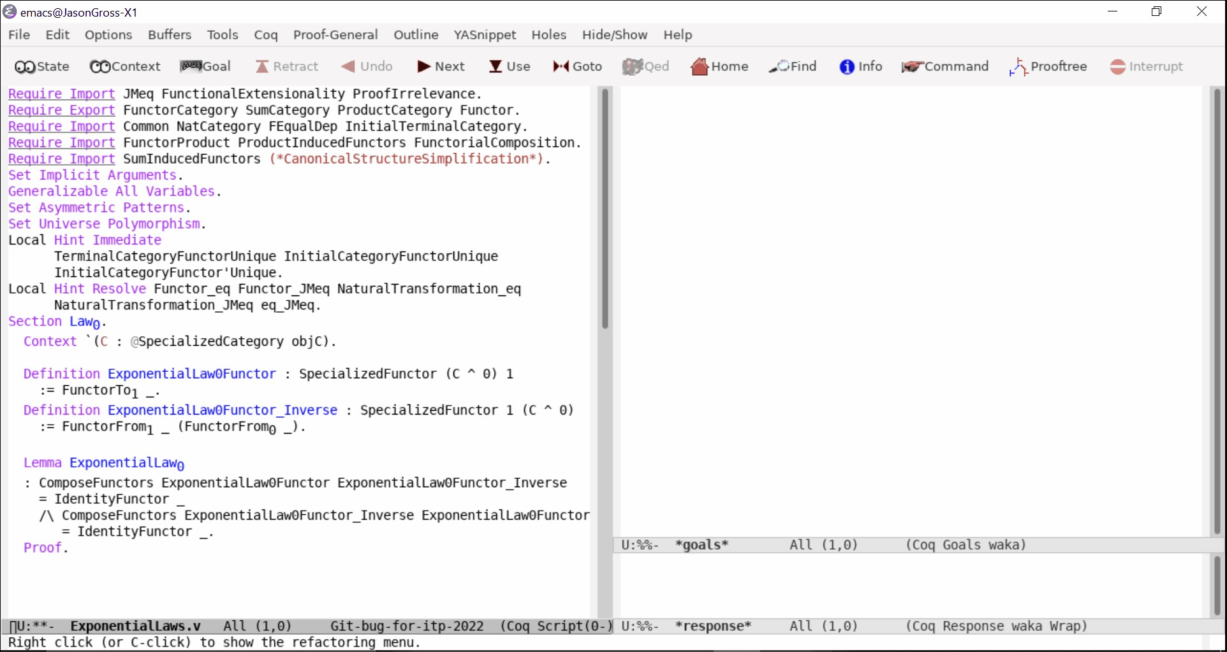
Category Theory Library Minimization in Coq

Slide 4
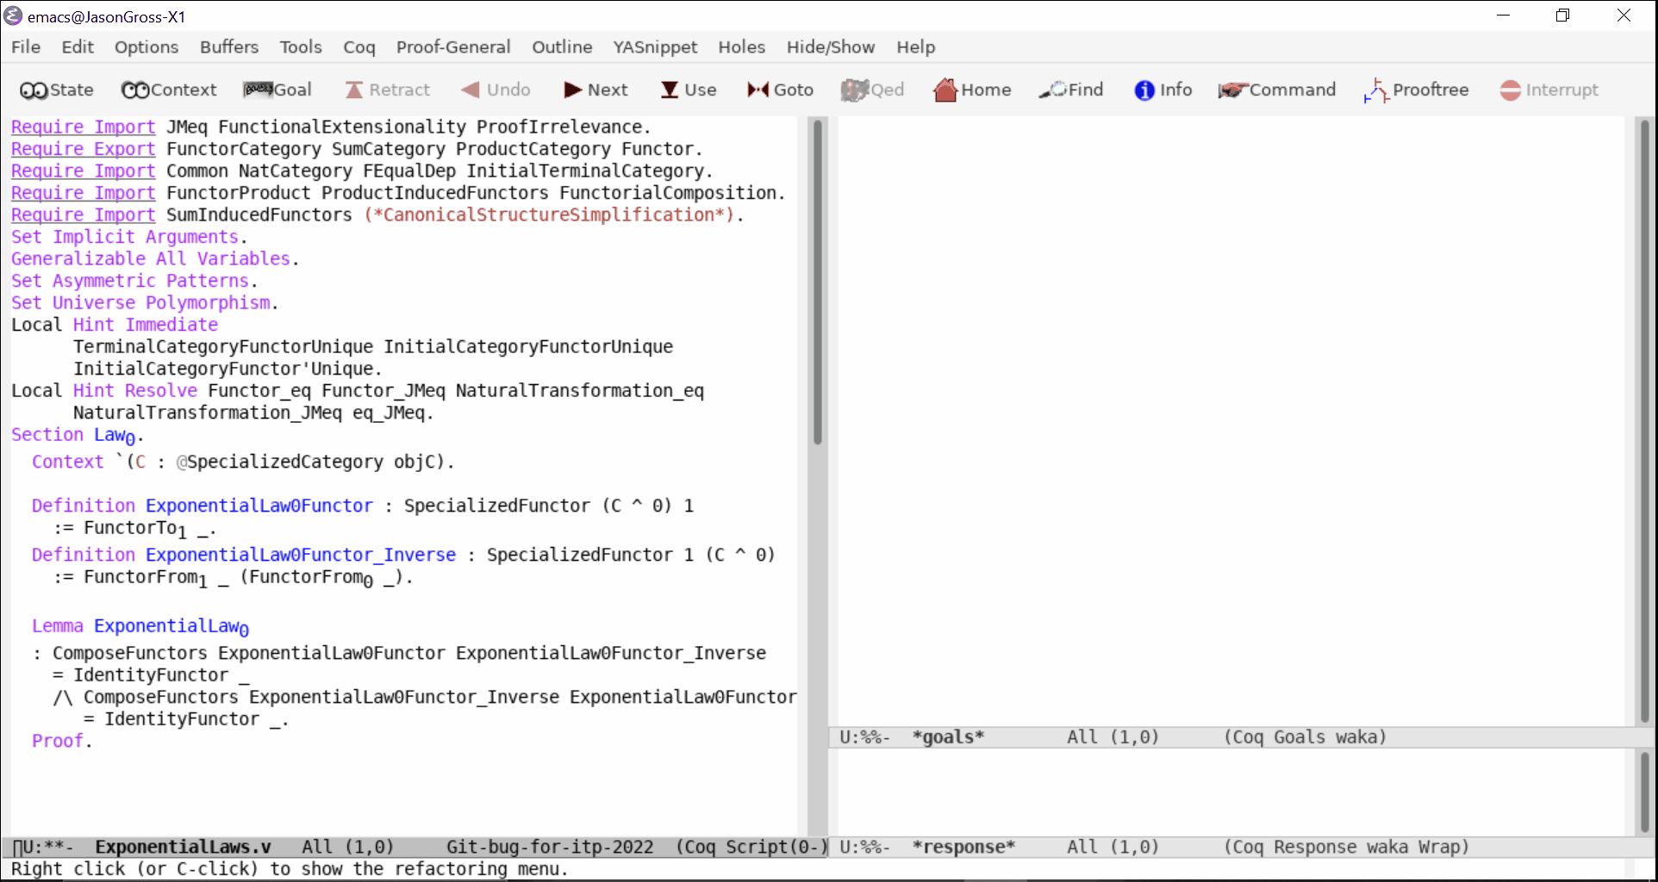
Category Theory Library Minimization in Coq

Slide 5
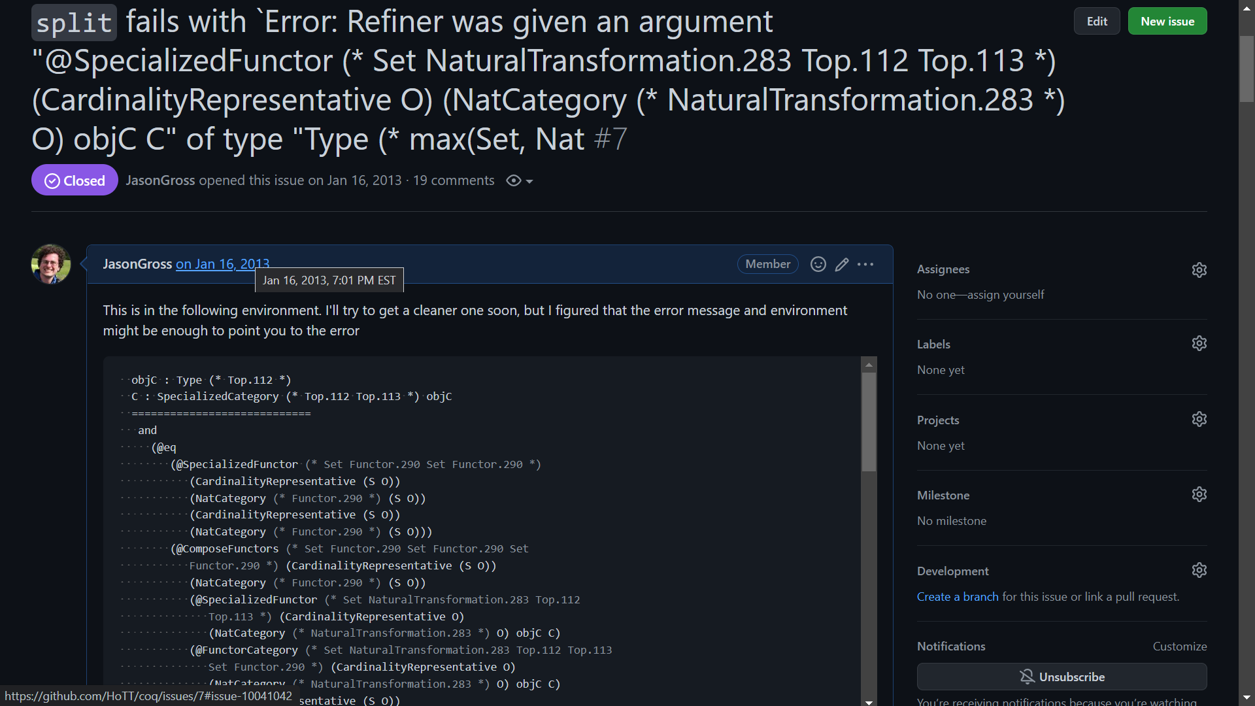

Slide 6
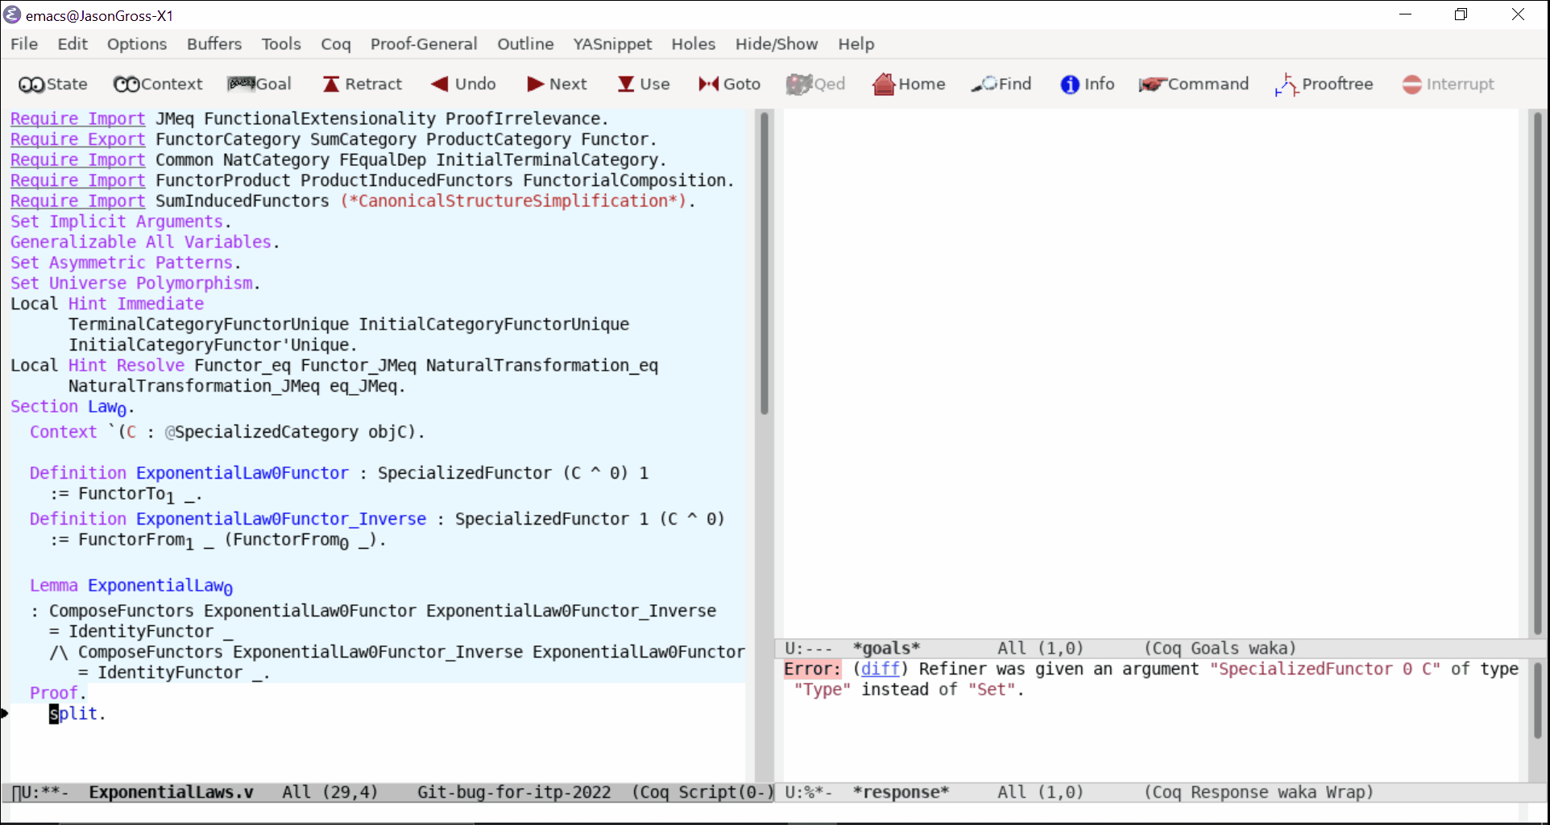

Slide 7
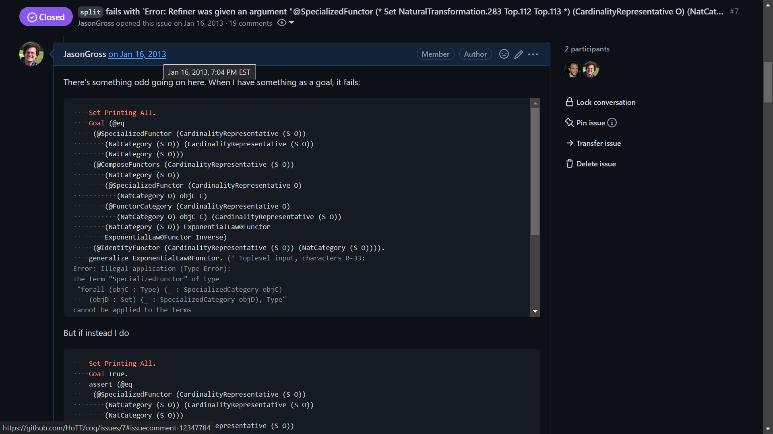

Slide 8
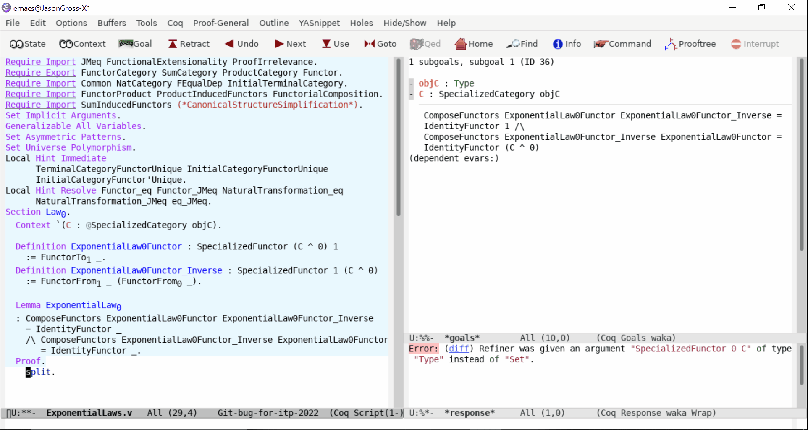
Category Theory Library Minimization in Coq

Slide 9
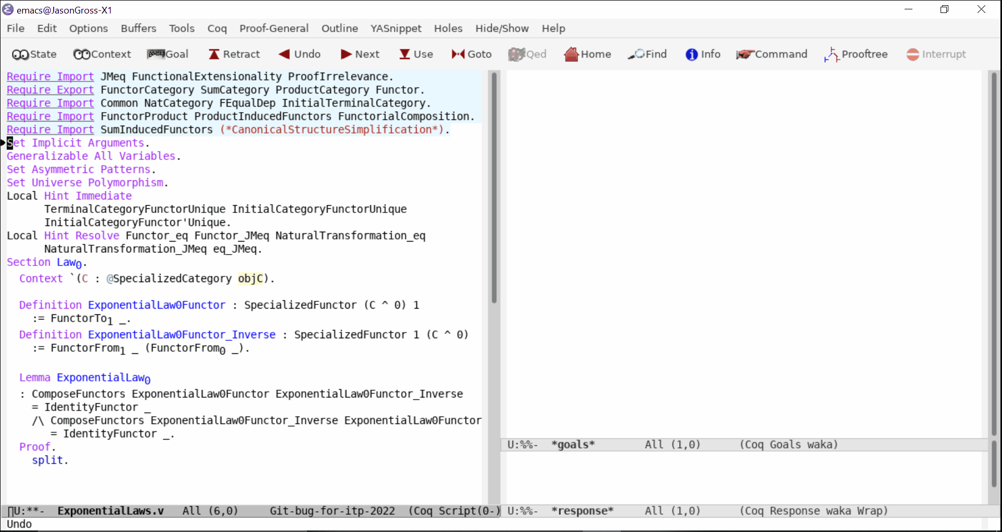
Category Theory Library Minimization in Coq

Slide 10
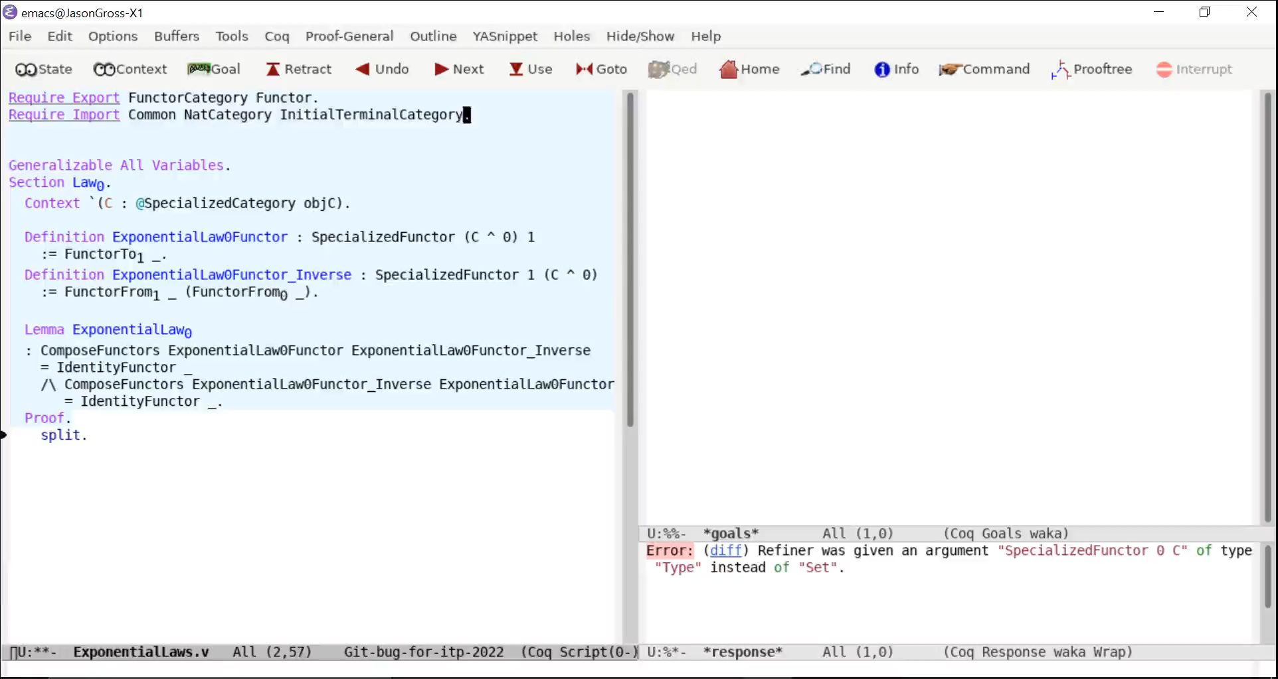
Category Theory Library Minimization in Coq

Slide 11
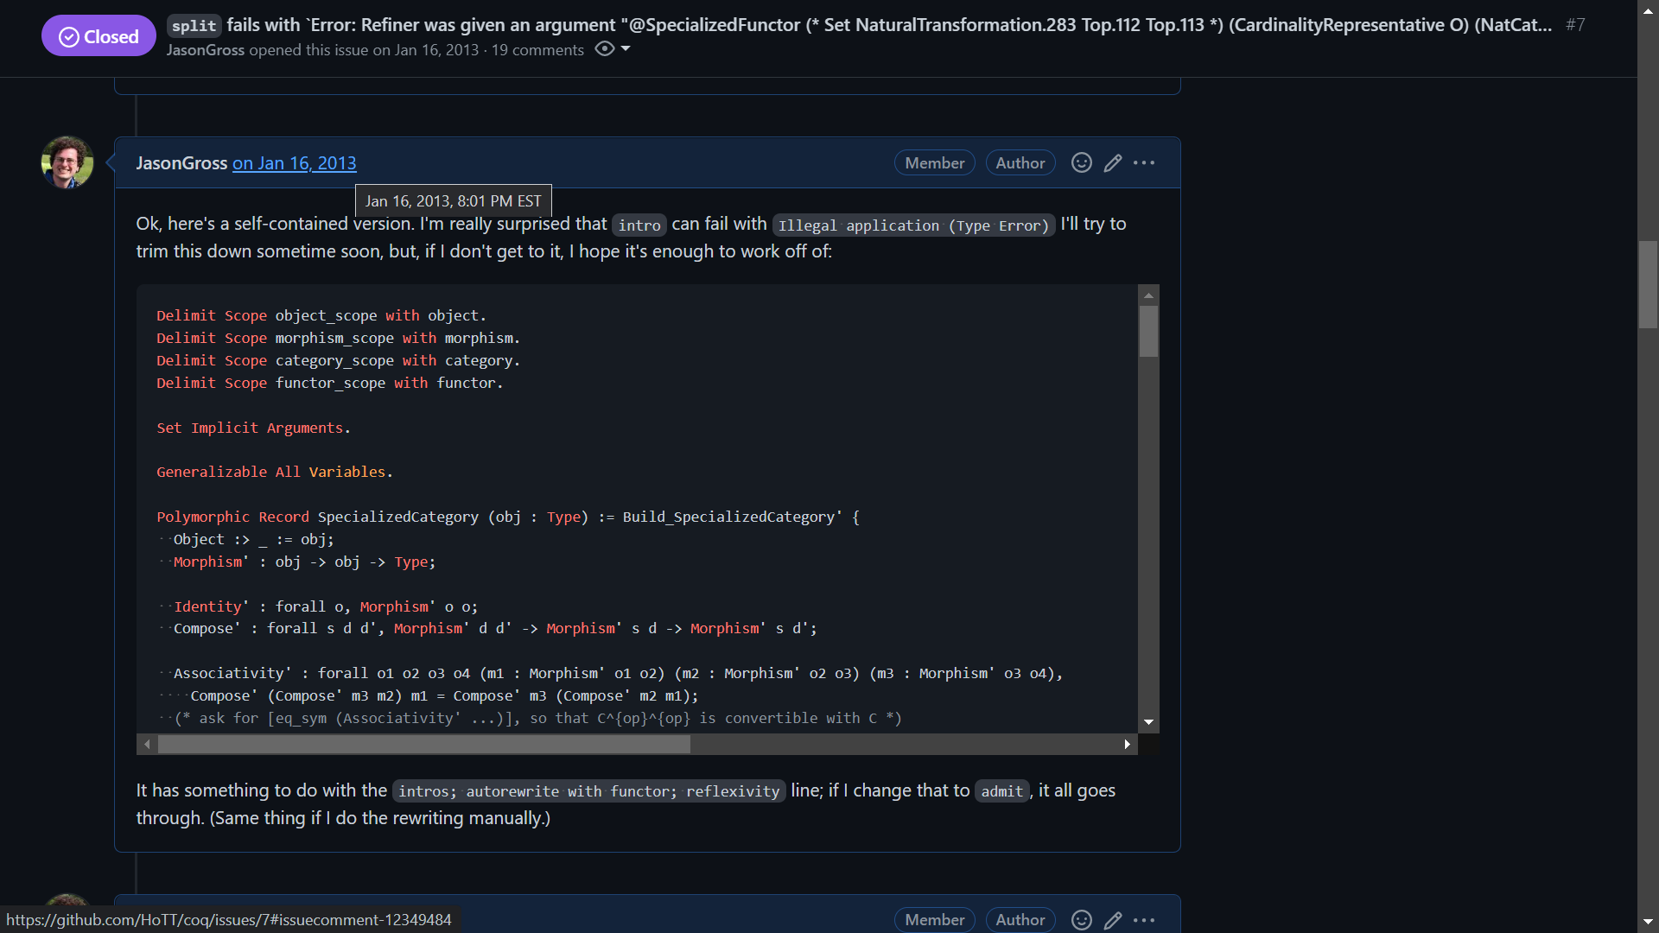

Slide 12
Origin Story: Coq Bug Reports By Year

Slide 13
Goal: Automate This!

Slide 14
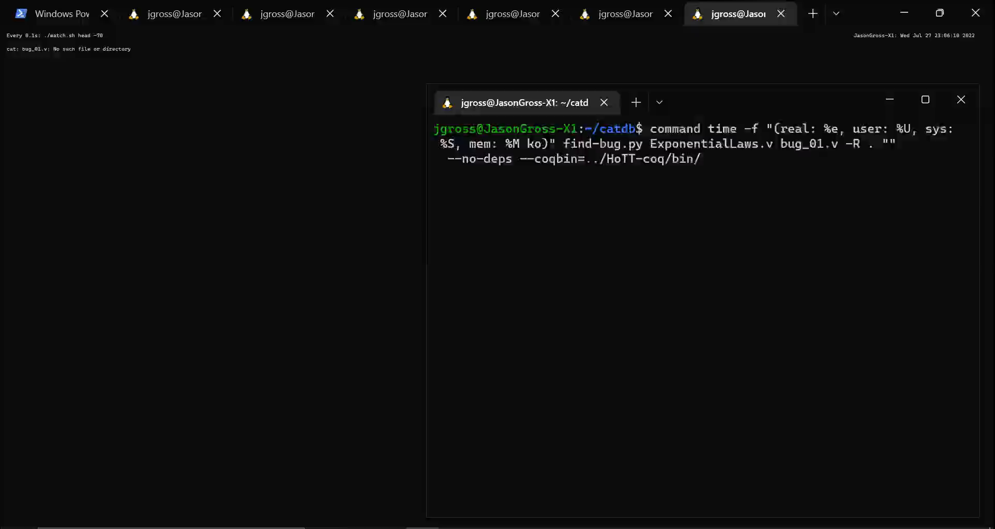

Slide 15
Debugging Regressions: coqdev experience

Slide 16
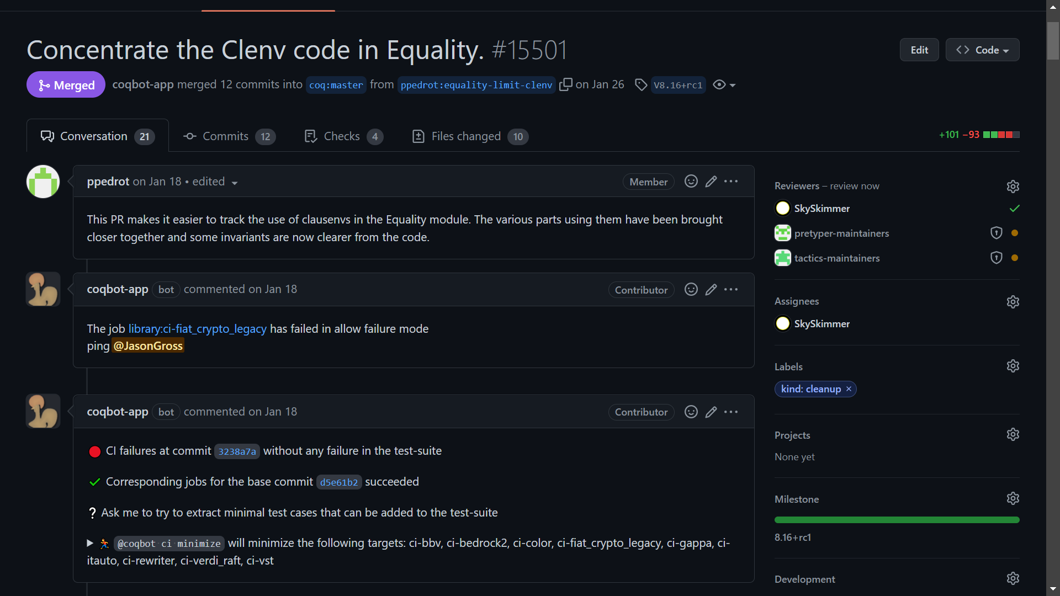


Slide 17
CI Running Time

Slide 18
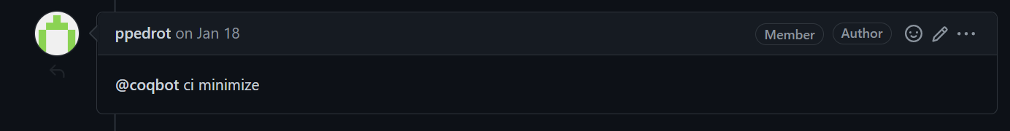

Slide 19
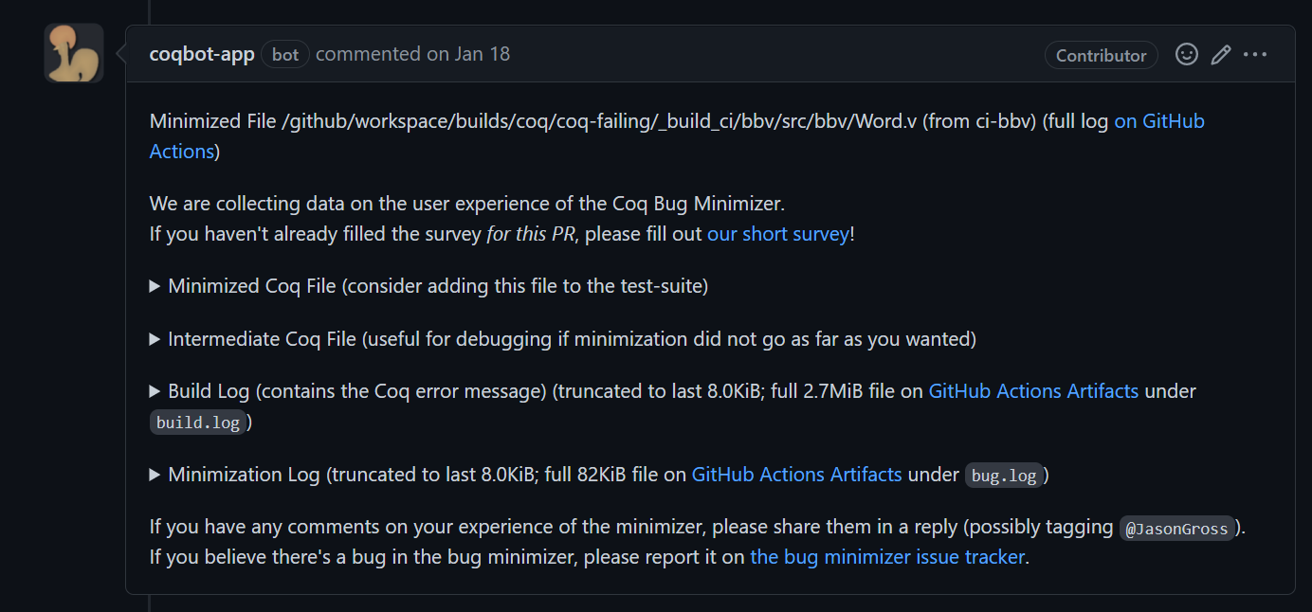

Slide 20
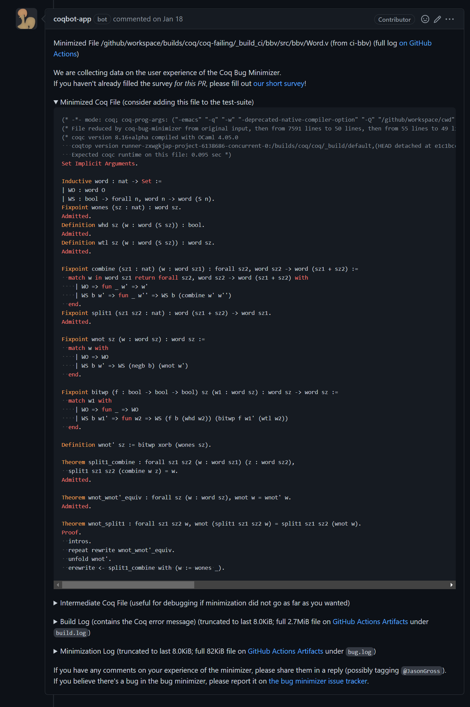

Slide 22
How Long Does It Take?

Slide 23
Minimizer Running Time CDF

Slide 24
How Long Do Projects Take On CI?
Selected CI Jobs, January through July 2022
Modified box plot for seven-number summary + mean

Slide 25
How Much Do We Minimize?
Better

Slide 26
How Minimal is Minimal in Absolute Terms?
Better

Slide 27
Specification Summary
Input: a development displaying a potential problem with Coq
Output: a single (shorter, faster) file displaying the same behavior
Desires:
File should be standalone, as short as possible, as fast as possible
Fully automated, no interaction beyond pointing it at the issue initially
Interruptible and resumable: user should be able to do a manual pass over the file at any point and resume automatic minimization from there

Slide 28
Specification Details
What does “the same behavior” mean?
In bug reporting case: “same” error message, without changing the final bit of code
“print ‘exact error message’” is not a valid minimization
In CI case: should also succeed on the master version of Coq

Slide 29
What needs to be automated?
Workflow automation (responding to user’s comment, replying as a comment)
Removing code to shorten example (in compile time and LoC)
Adjustments to minimize compile time
Inlining and linearization (to reduce complexity)

Slide 30
How do we do this?
Interfacing with Coq externally
Delta debugging / brute force
Tricks for inlining
To Achieve Adequate Performance:
Inline files one-by-one
Remove proof scripts as early as possible
Linear pass to remove code, don’t consider all subsets

Slide 31
Delta Debugging / Brute Force Removal
“Trust me, it’s true” primitives
Not line by line, but blocks
Minimal coupling, lack of forward references

Slide 32
Coupling
Coupling in Agda:
data ℕ : Set where
zero : ℕ
succ : ℕ → ℕ
data Even : ℕ → Set
data Odd : ℕ → Set
data Even where
even-zero : Even zero
even-succ : ∀ {n} → Odd n → Even (succ n)
data Odd where
odd-succ : ∀ {n} → Even n → Odd (succ n)

Slide 33
Coupling
Coupling in Agda:
data ℕ : Set where
zero : ℕ
succ : ℕ → ℕ
data Even : ℕ → Set
data Odd : ℕ → Set
data Even where
even-zero : Even zero
even-succ : ∀ {n} → Odd n → Even (succ n)
data Odd where
odd-succ : ∀ {n} → Even n → Odd (succ n)
Missing type signature for data definition Even
when scope checking the declaration
…
Not in scope:
Odd
when scope checking Odd
The following names are declared but not accompanied by a definition: Odd
The following names are declared but not accompanied by a definition: Even

Slide 34
Coupling
✓
Coupling in Agda:
data ℕ : Set where
zero : ℕ
succ : ℕ → ℕ

Slide 35
Coupling
Coupled definitions are almost always single statements in Coq
Inductive ℕ : Set :=
| zero : ℕ
| succ : ℕ -> ℕ.
Inductive Even : ℕ -> Set :=
| even_zero : Even zero
| even_succ : forall {n}, Odd n -> Even (succ n)
with Odd : ℕ -> Set :=
| odd_succ : forall {n}, Even n -> Odd (succ n).

Slide 36
How do we do this?
Interfacing with Coq externally
Delta debugging / brute force
Tricks for inlining

Slide 37
Tricks for Inlining and Linearization

Slide 38
Name Changes on Inlining
A.v:
Definition foo
: nat := 0.
Definition foo
: nat := 0.
Definition foo
: nat := 1.
(* Error: foo already exists. *)
Print foo.
(*foo = 1 : nat*)
Print A.foo.
Module A.
Definition foo
: nat := 0.
End A.
Import A.
Definition foo
: nat := 1.
Print foo.
(*foo = 1 : nat*)
Print A.foo.
(*A.foo = 0 : nat*)
vs
B.v:
Require Import A.
Definition foo
: nat := 1.
Print foo.
(*foo = 1 : nat*)
Print A.foo.
(*A.foo = 0 : nat*)

Slide 39
Linearization
A.v
B.v
A.v
B.v
B.v
or
A.v
?
C.v
C.v
C.v

Slide 40
How to make your proof assistant amenable to minimization
Make it possible to have a single file with the same semantics as code in multiple files
Primitive for “trust me, it’s true”
Lack of forward references is nice
Don’t forget the last mile of automating integration with CI!

Slide 41
Future Work
More automation of bug reporter work flow
Better inlining
More minimization
Other proof assistants???

Slide 43
Extra Content

Slide 44
How Long Do Projects Take On CI?
Selected CI Jobs, January through July 2022
Modified box plot for seven-number summary + mean

